Slide 1
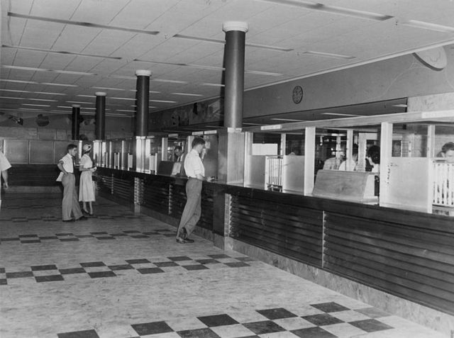
Notes:
Jimmy
think We want you to take a moment to think back to the last few visits you had at your bank branch where you saw a teller.
How did you feel when you were waiting? How did you feel throughout the process of your visit?
Perhaps some of you had great experiences where everything went find, just as expected.
But perhaps some of you felt intimidated, lost, or nervous. We asked these same questions to first year students here at the University of Waterloo, and this is how many of them felt when they visited their bank branch.

Slide 2

meet quinn.
01
a first year student
Notes:
Sharon
Meet Quinn, he is a first year GBDA student. Growing up he never paid much attention to banking and finances as he never felt the need to. He always left that to his parents while he focused on school and his music.
It’s the 1st week of college and now he needs to open his first bank account. The problem is he feels uncomfortable approaching his local bank and interacting with the banking staff. The task of setting up an account seems extremely daunting to him, considering he has little to no financial literacy. As a customer he would love his banking experience to be less formal, distant and more in touch with his peer group.

Slide 3
research process.
01
surveys & interviews
03
customer journey map
05
02
04
research plan
consolidate findings
prototype
Notes:
Lea
We arrived at a story like Quinn’s after having open conversations with 1st year students about their overall banking experience
After 16 Interviews and a discussion post on Reddit, we discovered that a majority of incoming first-year international students had not heard of the big 5 banks prior to arriving in Canada, and in general

Slide 4
stats.
56%
25%
“banks are…”
expressed minimal confidence with their financial literacy.
dread the long waiting times when visiting their local bank.
formal
dull
serious
INTIMIDATING
out of touch
Notes:
Lea
56% of students interviewed expressed minimal confidence in their financial literacy
25% noted expected long waiting times for their bank visits
Students expressed that they appreciated the fact that the employees genuinely cared about them, beyond them being just a customer.
Among these, we heard that many felt that they perceived banks as formal, distant, serious, intimidating, dull, too professional and out of touch with youth. This, we decided, became the focus of our project.

Slide 5



customer journey.
o-week booth
commit
bring documents
stand in queue
access funds
customer support
make appointment
bus to bank
conduct regular transactions
improve financial literacy
meet with advisor
research
Discovery
Open Account
Loyalty
Notes:
Lea
Here’s a basic overview of a 12-step journey through a first-year’s initiation and ongoing relationship with their bank divided into three phases: discovery, starting account, and ongoing relationship.
Looking at our data, we noted several points in this journey that, more often than not, become pain points for students.
set up appointment
commute and wait in queue
meet with teller
conduct regular transactions
receive customer support
improve financial literacy
These areas involve coordinating schedule, direct contact with bank representatives, and travelling to and being in the physical bank space.
While our research noted that students tend to conduct their transactions online or through mobile apps for convenience, some concerns about security were raised. As well, there are times when face-to-face contact with representatives is necessary.

Slide 6

problem.
01
“I feel intimidated.”
Notes:
Quinn

Slide 7
what people say.
01
02
03
“I don’t have time...”
“It’s too far away...”
“It’s not important...”
Notes:
Quinn
Students not taking full advantage of all the services banks offer that are included in their account due to a lack of financial knowledge
And they weren’t seeking out financial help because:
They’re afraid and intimidated of finances
Have to book an appointment with financial advisor
Seems too formal
Takes initiative and time
Doesn’t seem that important to them at the moment when they are focused on school
After identifying stressors in the journey for our demographic we came to one question: how can we make the banking experience more welcoming and comprehensive for first year students new to banking?

Slide 8

Our Solution
Notes:
Michelle

Slide 9

The Break
A peep at some distant orb has power to raise and purify our thoughts like a strain of sacred music.
Notes:
Michelle

Slide 10
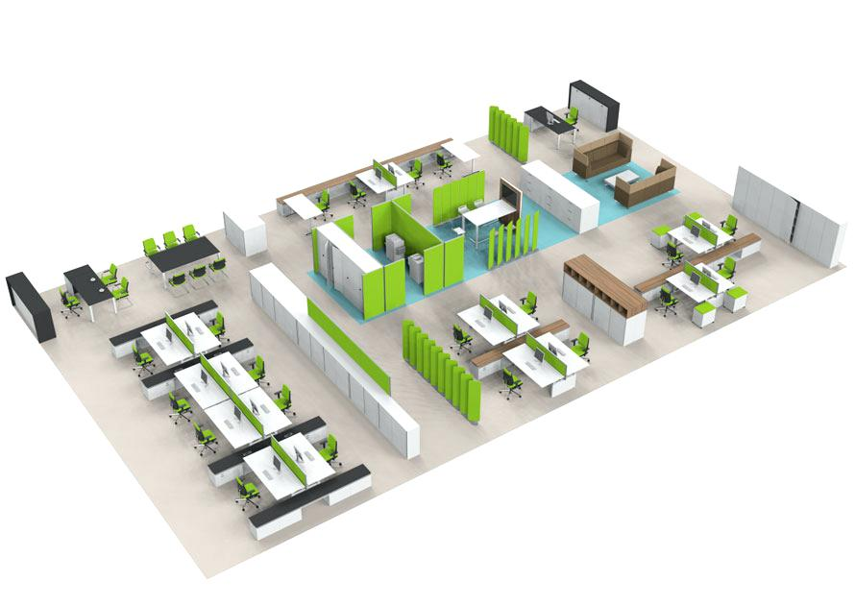
floor plan.
02
studying & coworking
meeting rooms
cafe, lounge, & event space
bank, ATMs, & advisors
01
Notes:
Michelle

Slide 11
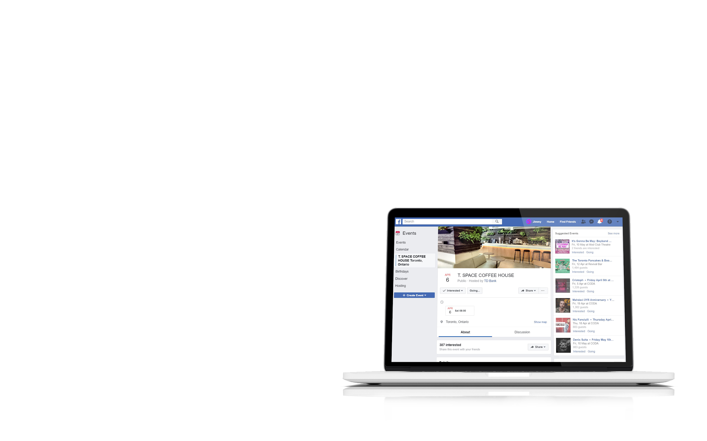
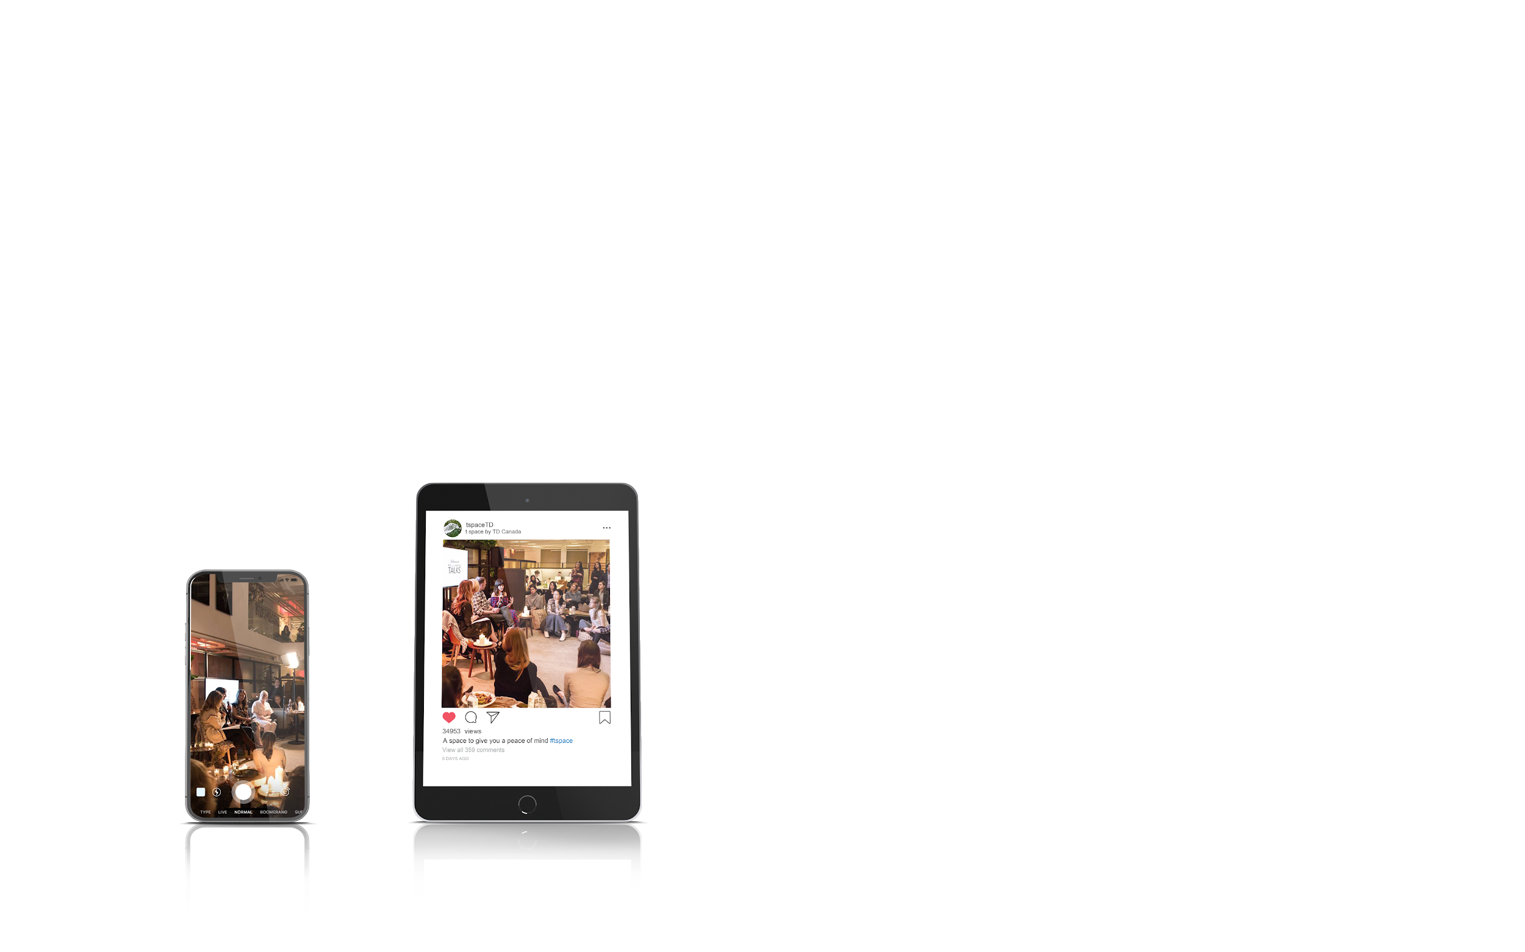
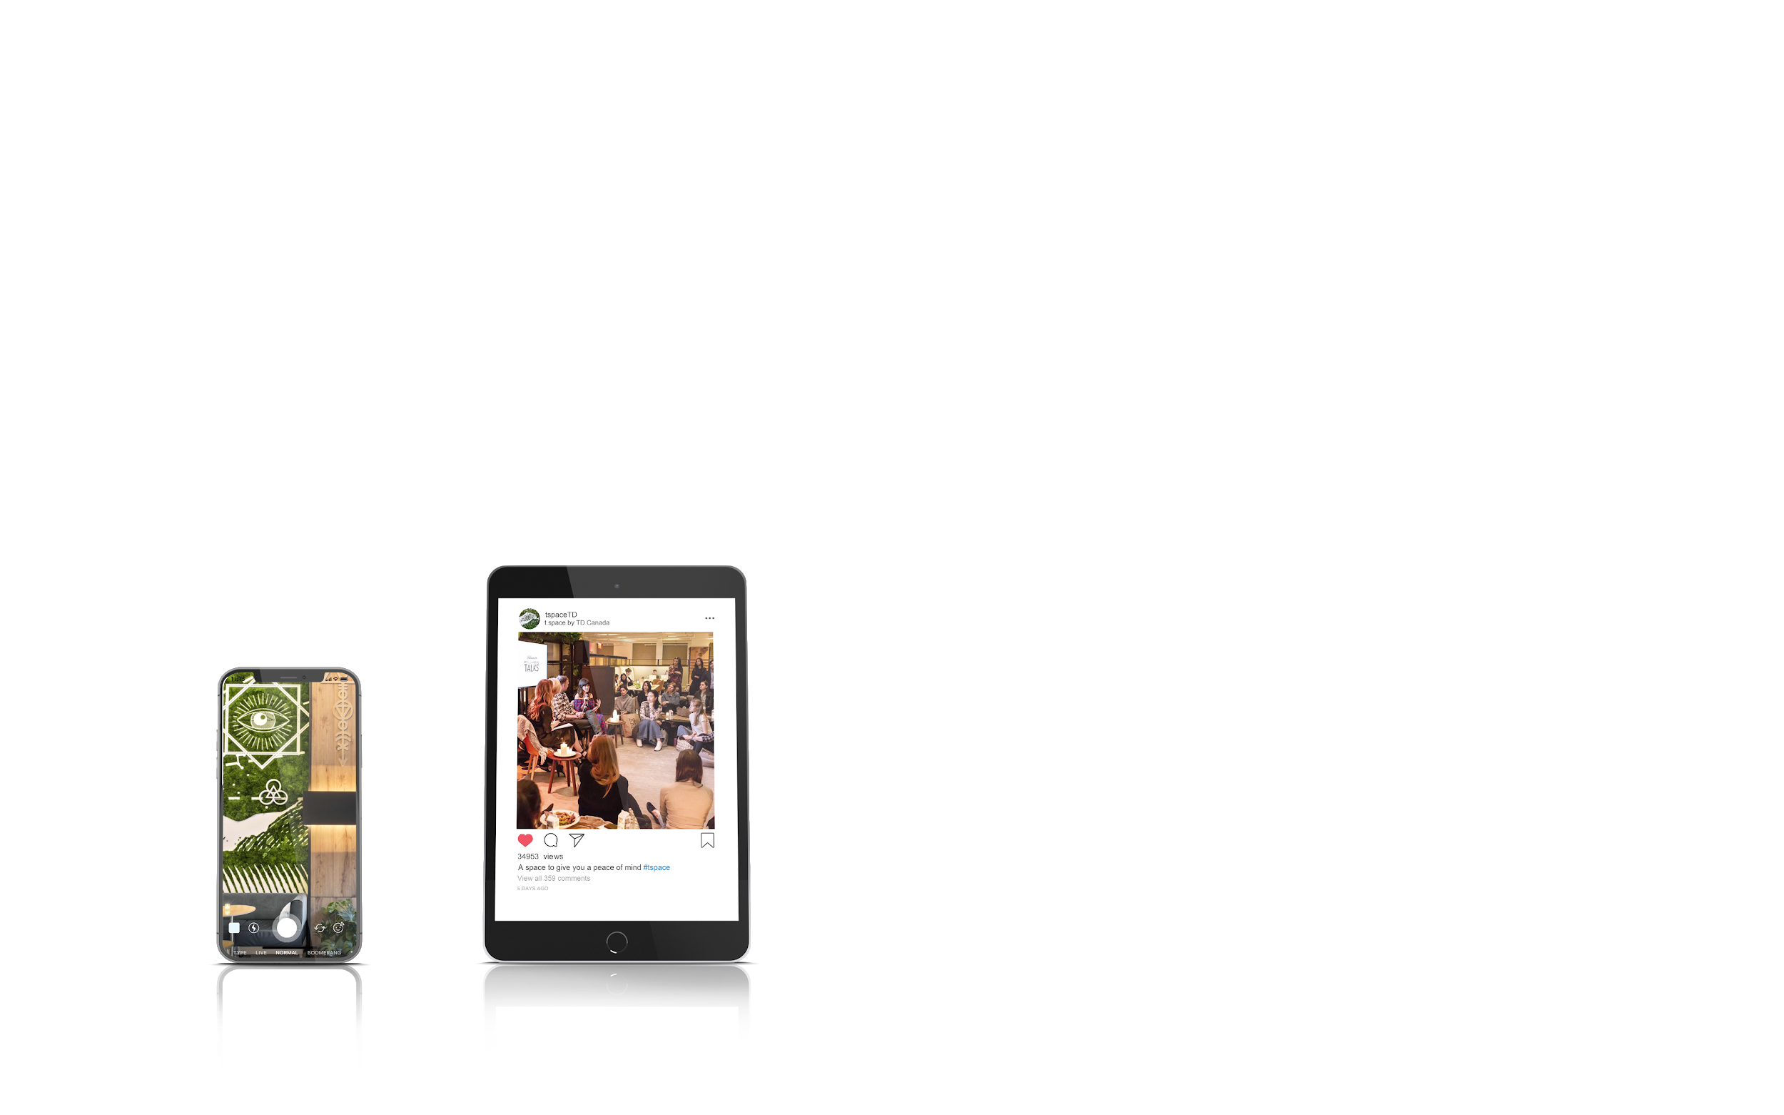
a
space
to build relationships.
01
Notes:
Michelle

Slide 12

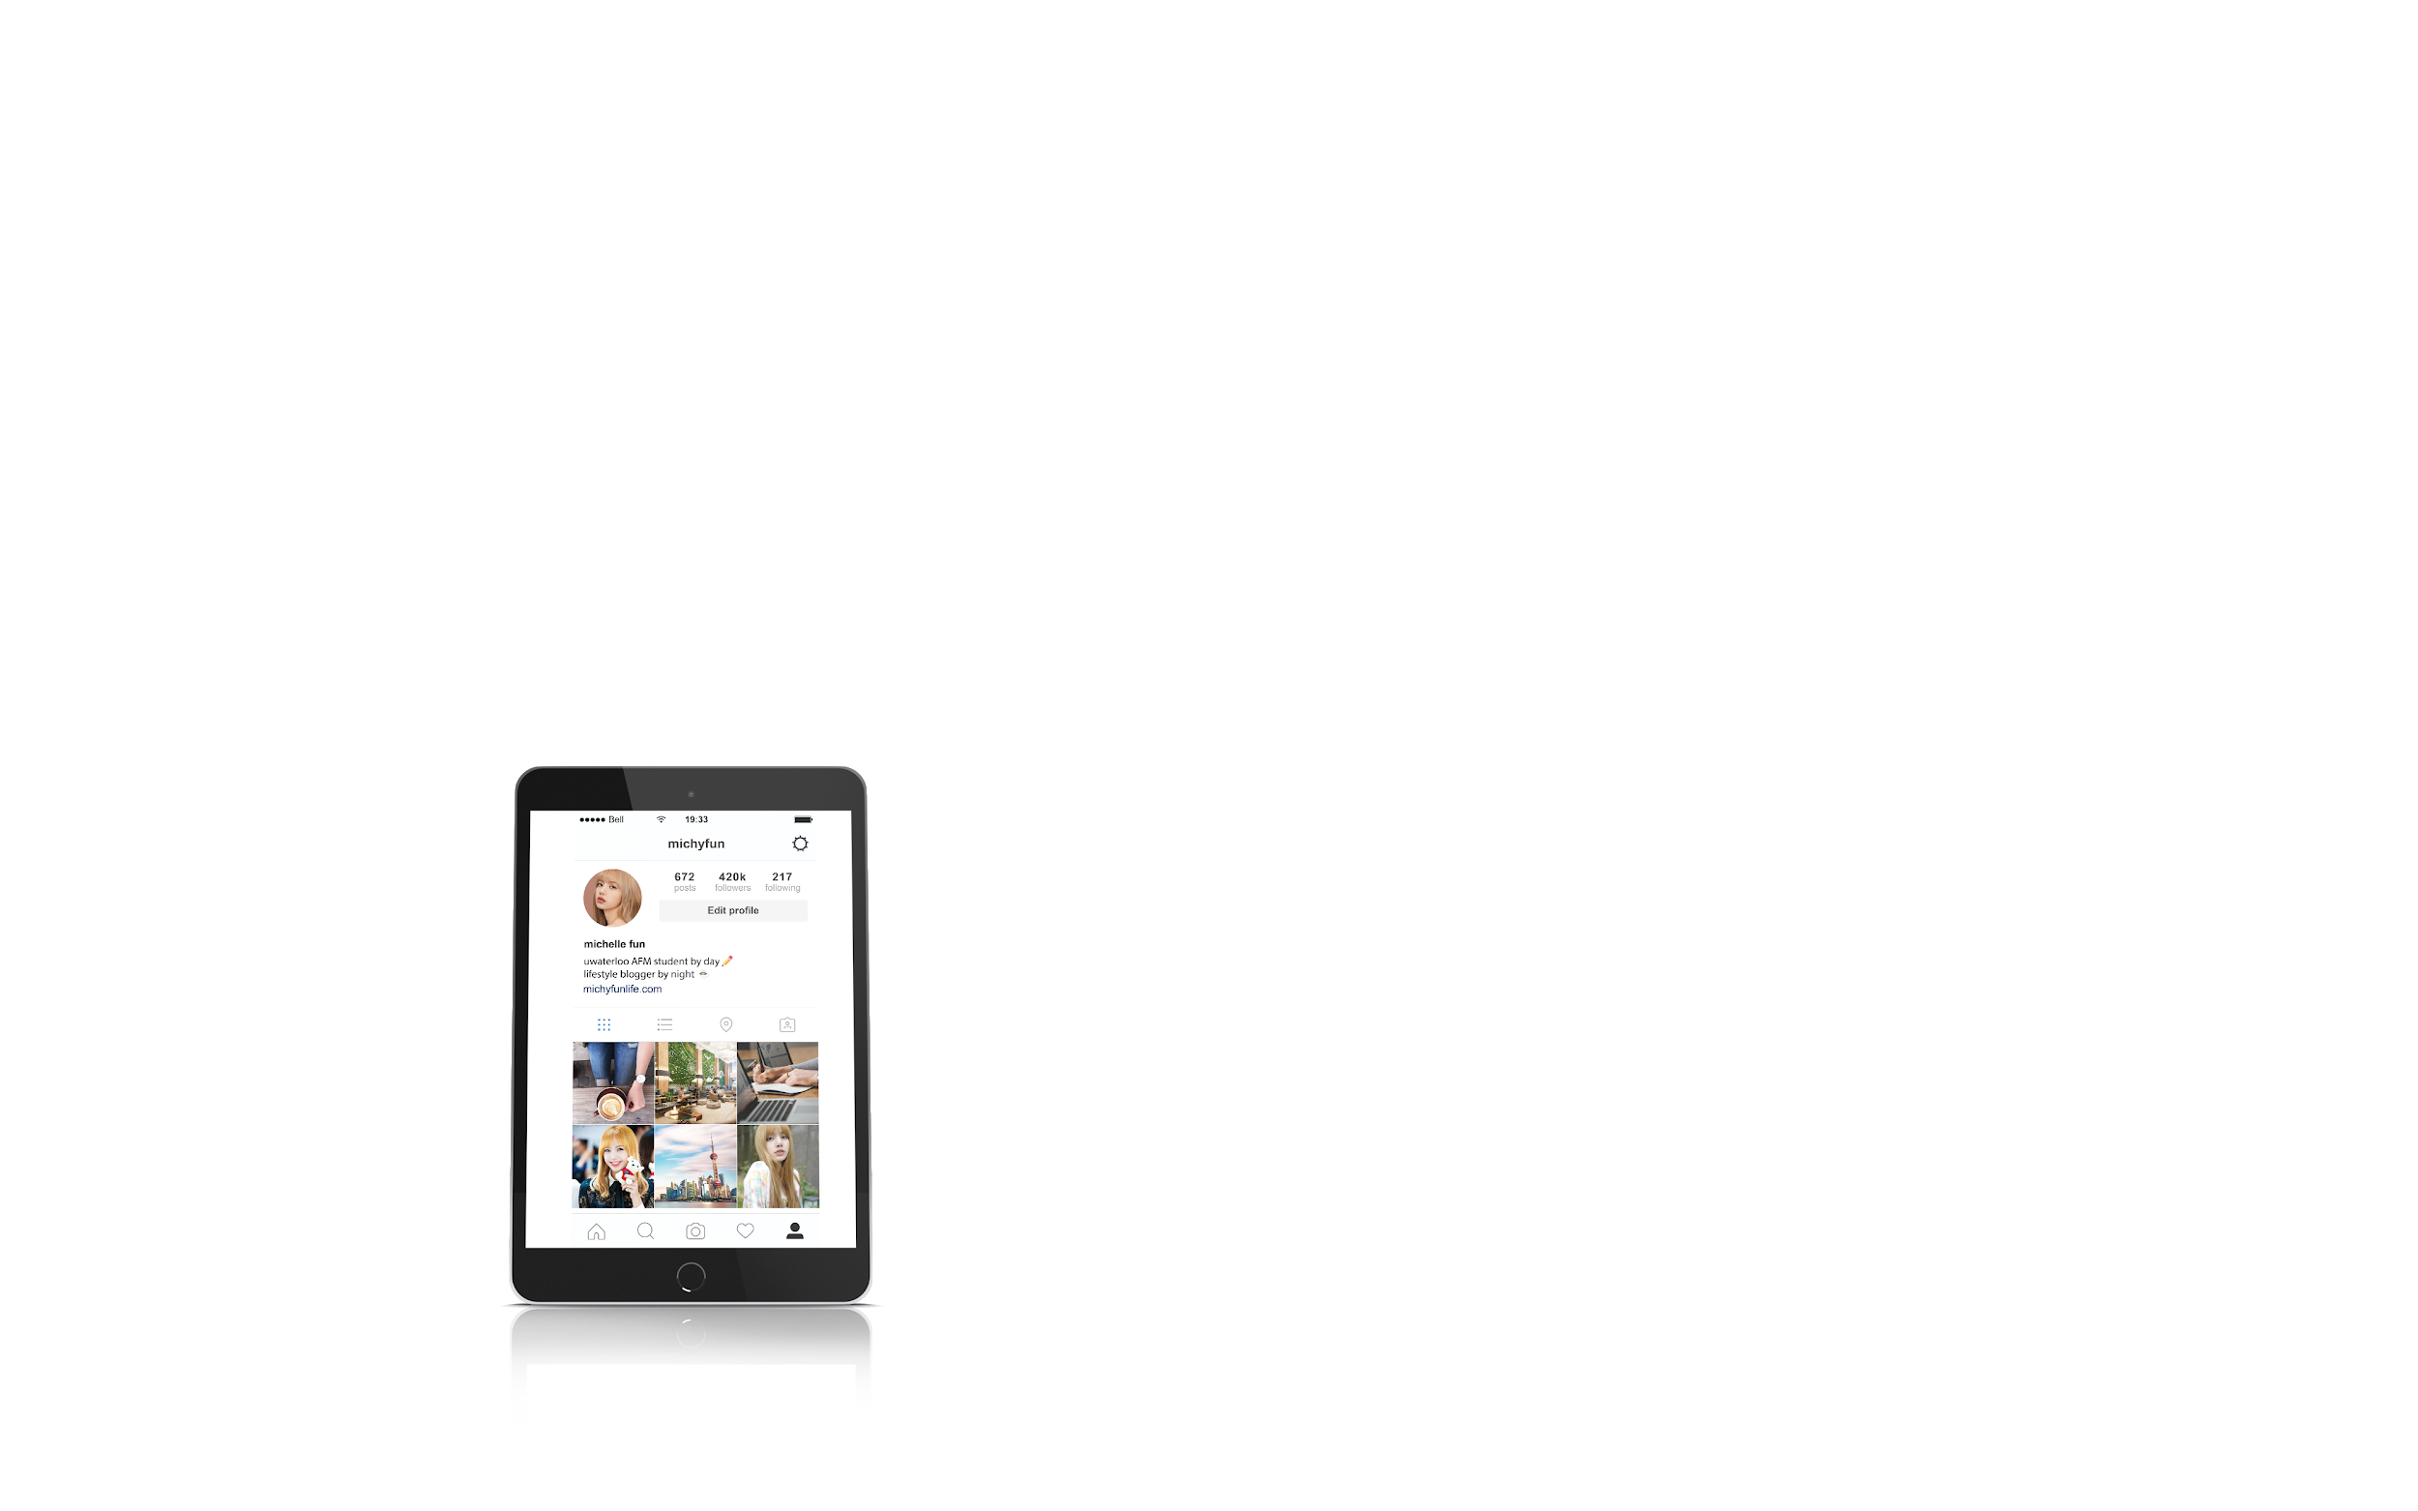
a space to influence.
01
Notes:
Michelle

Slide 13

a
welcoming space.
01
Notes:
Michelle

Slide 14
solution fit.
01
02
03
“I’d feel comfortable...”
“It’d be so close...”
“I’d have
the time...”
Notes:
Jimmy
Let’s take a moment to think back to our problem. They don’t feel comfortable approaching a financial advisor. Their bank branch is too far away and inconvenient for them to visit. And as a result, they don’t have the time to go off of campus for appointments.
But after pitching our idea to millenials, they’ve expressed that:
They would feel more comfortable meeting an advisor in that kind of environment.
With a collaborative space at the heart of campus, meeting with their bank advisor would be much more convenient
With a space where they’re already visiting to study, students can have the time to visit their advisor while they’re grabbing lunch or coffee
Thus solving the problem: “how can we make the banking experience more welcoming and comprehensive for first year students new to banking”

Slide 15

we are.
Notes:
This is our team.
Hi, I’, _____...
Sharon: 3B Computer Science, Research and Content Specialist
Quinn: 1B GBDA, Research and Content Specialist
Jimmy: 4B Arts and Business, Project Manager
Michelle: 4B Environment and Business, Design Specialist
Lea: 4B Liberal Studies, Design
And together we bring our diverse expertise in design, user experience, and project management to bring a new banking experience to the table.

Slide 16
takeaways.
01
transform the culture
02
disregard norms
03
let go of assumptions
Notes:
Jimmy

Slide 17

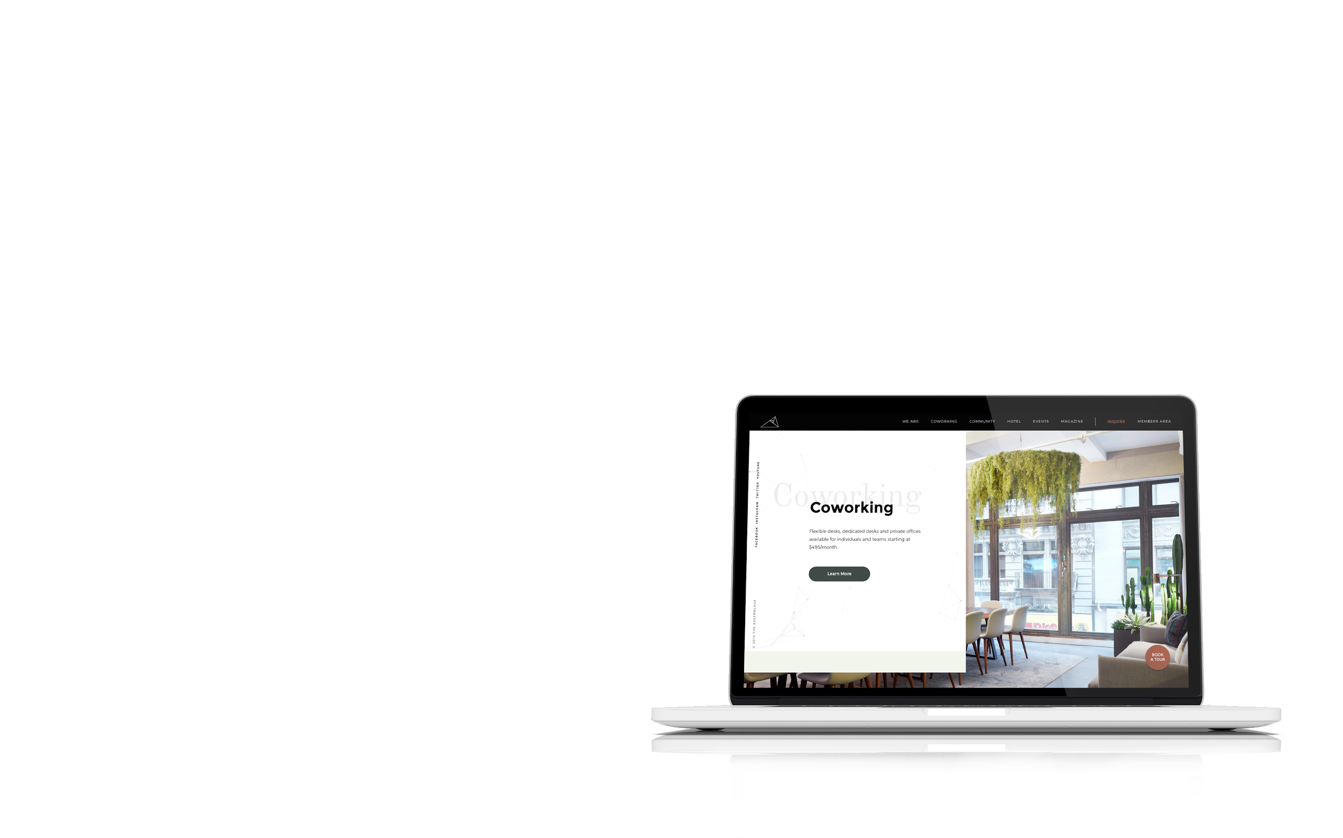
welcome.
to a
new
banking
experience
Lea Clarin
Michelle Sin
Quinn Harder
Jimmy Quach
Sharon Olorunniwo
Notes:
Jimmy

